Slide 1
Cse 416
Generalization and Specification
with Databases

Slide 2
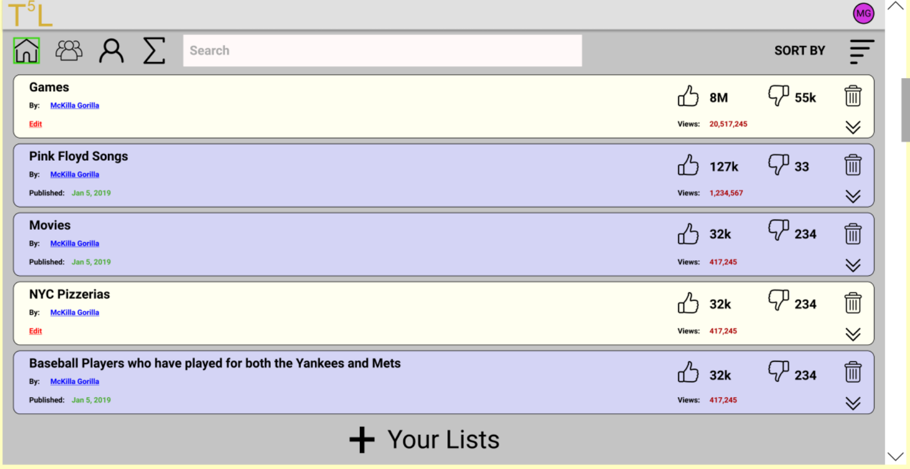
CRUD
Create Retrieve Update Delete
We’ve neglected some aspects of this
we haven’t really dealt with CRUD combinations
we haven’t really dealt with filtering/pagination
we have only had simple things to retrieve (just Top 5 Lists and Users)
Data Designs can get much more complicated
we can’t have our client retrieve the entire database to use a small portion of it

Slide 3
Mongoose has many functions for finding things
For each of these, you provide the search criteria argument:
Model.find()
Model.findById()
Model.findByIdAndDelete()
Model.findByIdAndRemove()
Model.findByIdAndUpdate()
Model.findOne()
Model.findOneAndDelete()
Model.findOneAndRemove()
Model.findOneAndReplace()
Model.findOneAndUpdate()
For complicated things involving multiple Collection, best to send query criteria and let the back-end API work it out
Sorting, filtering, paginating data may require caching
await Top5List.findById({ _id: req.params.id }, (err, list) => {
…

Slide 4
How might we find search results?
As part of a request, send query data in body payload
query {
startsWith : "Pink",
createdAfter: "Jan 30, 2012"
}
Obviously the client and server have to agree on the format
can this process be standardized?

Slide 5
Again, Requests Can Get Complicated
Imagine a Database like SOLAR
maybe it has Student, Course, and Classroom Collections
What might someone want?
Find all students registered for CSE courses to be held in New CS
Requires search criteria to be applied to three different Collections
with a large database we have to be mindful it gets implemented efficiently

Slide 6

There are libraries that aim to help
GraphQL
Facebook Query Language and execution engine
Specify what you want, not how to get it
Can be used with any Front-End API

Slide 7
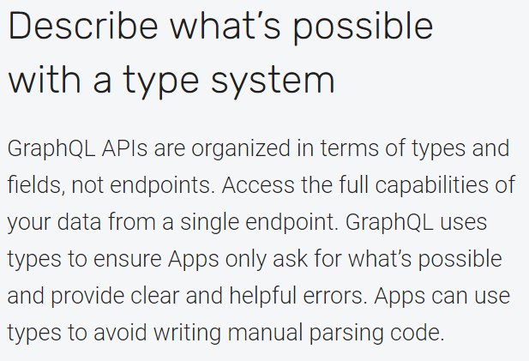
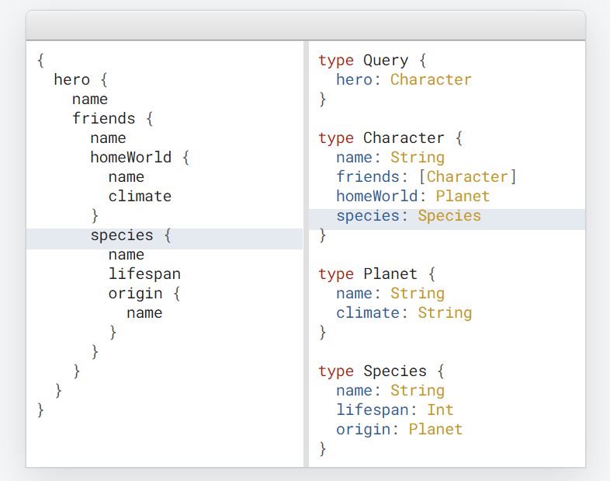

Slide 8
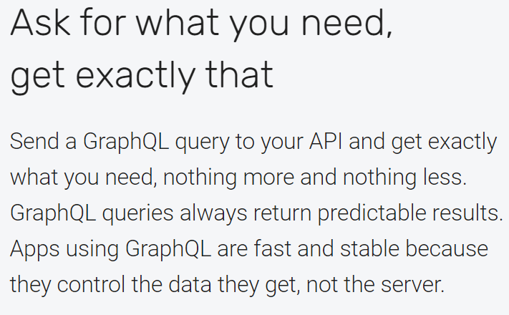
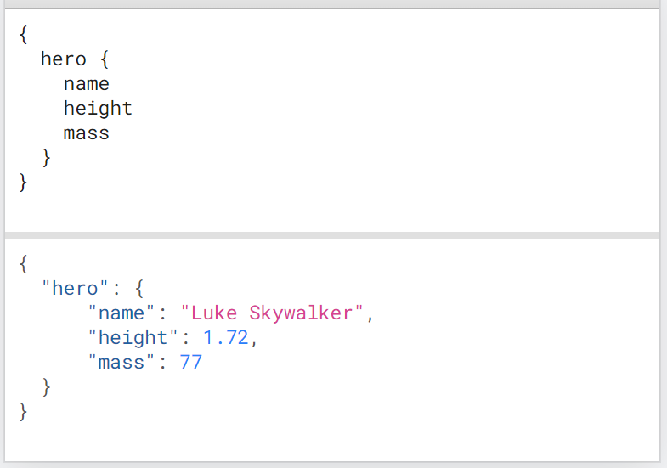

Slide 9
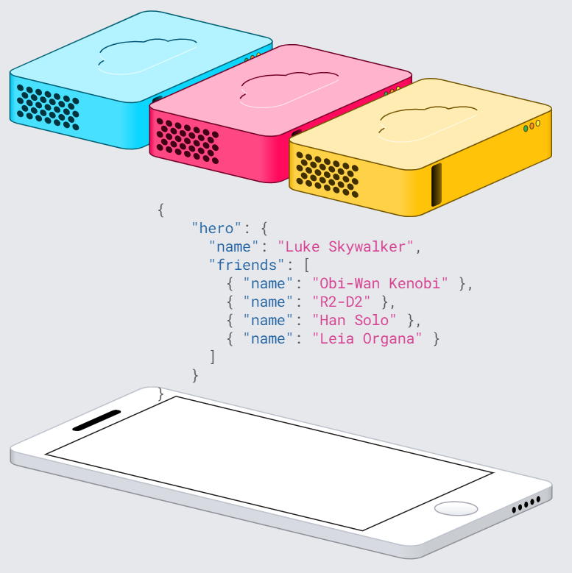
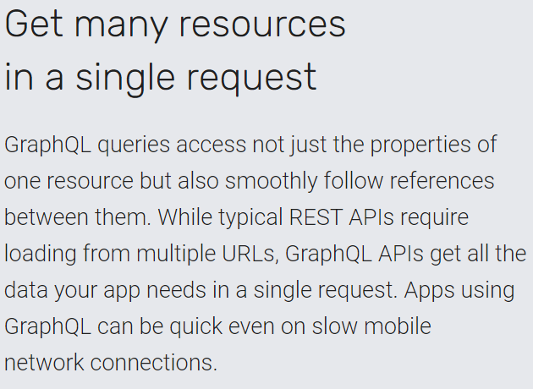

Slide 10
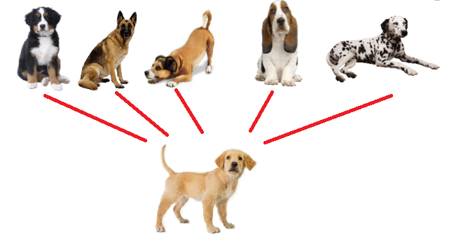
Software Generalization
A process of extracting shared characteristics from two or more objects/processes and combine them into generalizing objects/ processes.
What’s the purpose?
manage shared characteristics in a common way
To what end?
improved flexibility, reusability, etc.

Slide 11
Software Specialization
Providing specialized detail to generalized types
i.e. customization
How?
subclass implementations
follow generalized interfaces

Slide 12
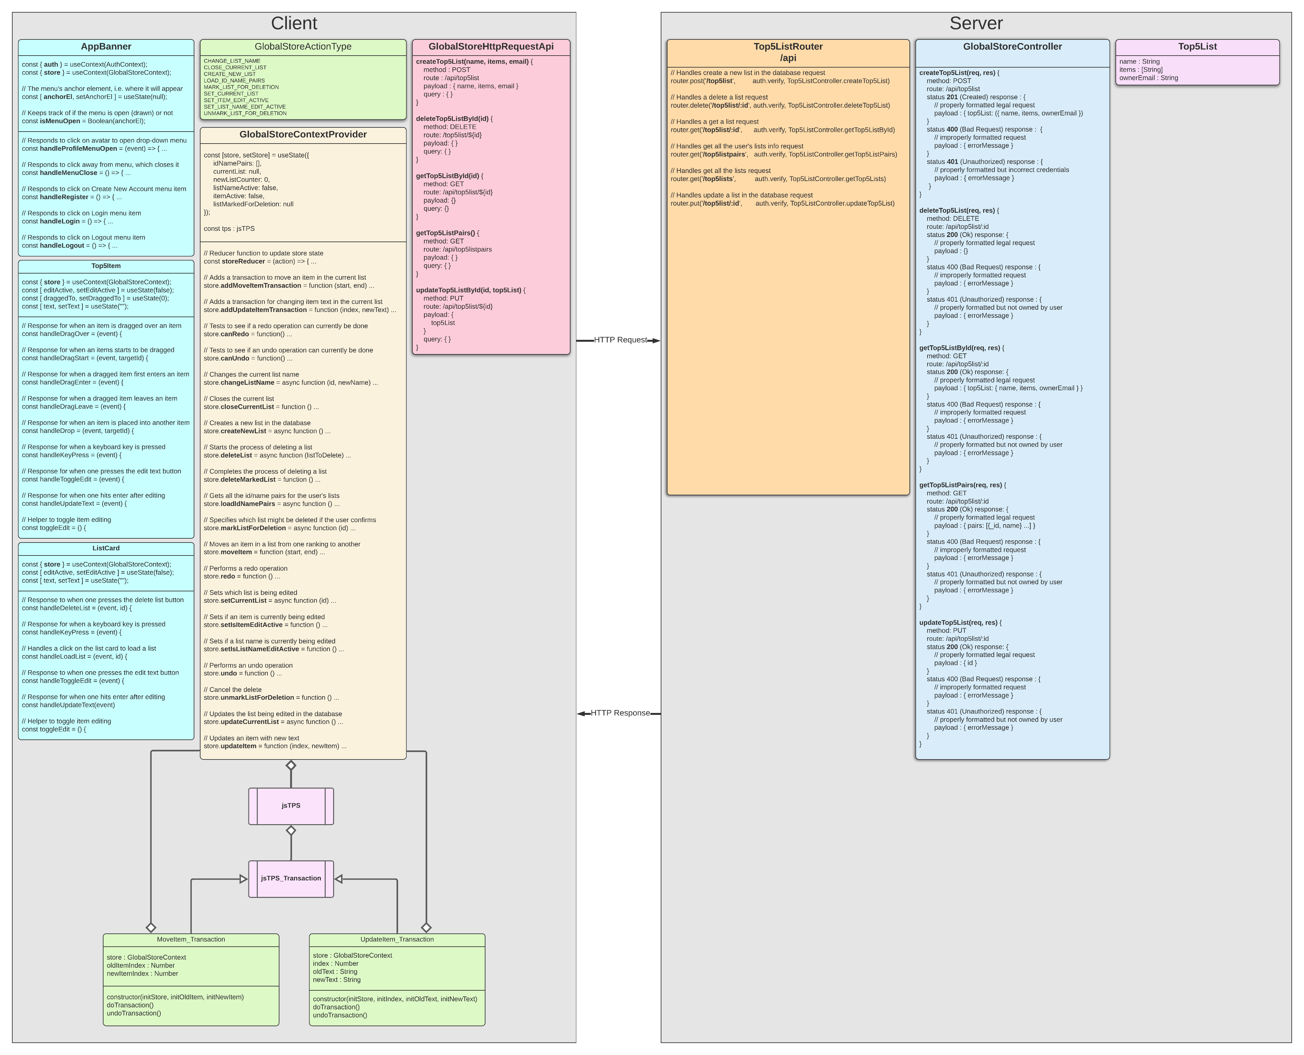
Let’s think about a specific problem
How could we generalize database communications?
i.e. decouple request handling from database CRUD
Why?
make it more modular
make it easier to update or change
flexibilty

Slide 13
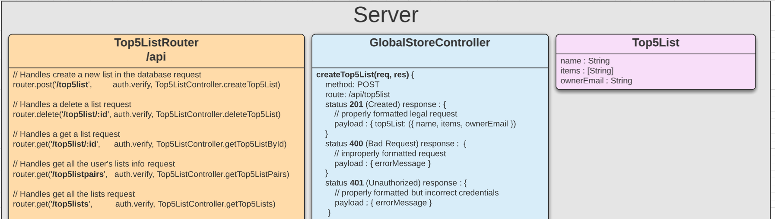
Let’s think more specifically
How could we change our back-end API so that we could change it to use MySQL with minimal changeover/expense?
We need another column between blue and purple
How should we do that?
generalize blue to purple communications in the blue component (i.e. remove all Mongoose and Schema references)
specialize they way those interactions happen in a new column (let’s make it green)

Slide 14
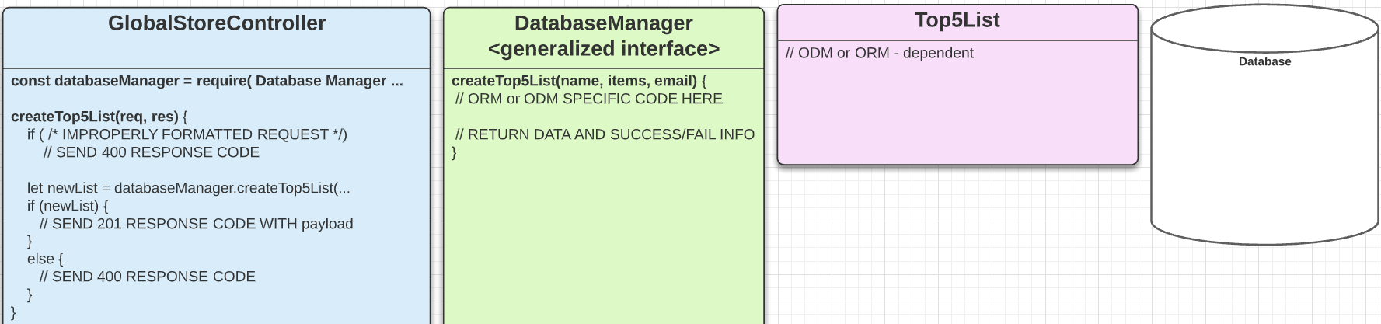
First we need to generalize
Using a Database Manager (ODM for MongoDB)

Slide 15
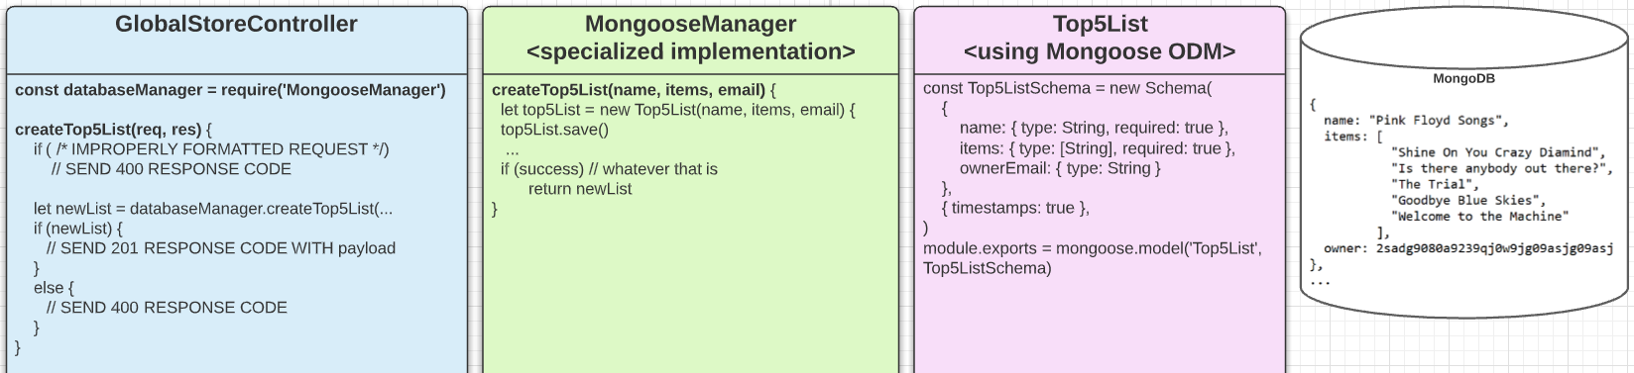
… and then Specialize
Using a Mongoose Database Manager (ODM for MongoDB)

Slide 16
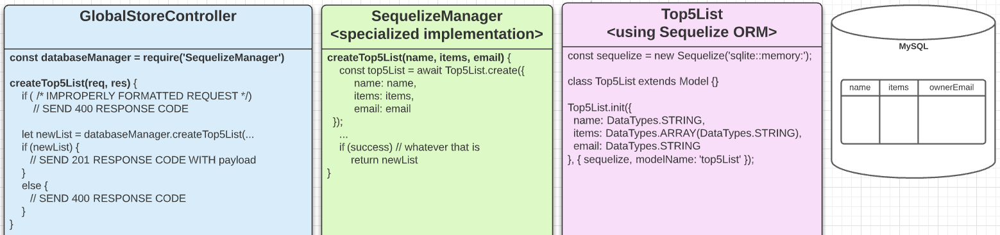
… and maybe Specialize again
Using a Sequelize Database Manager (ORM for MySQL)

Slide 17
References
Generalization in the context of Software Engineering
by Prabath Ariyarathna

